Slide 1
LAB – 11
Pointers and structure

Slide 2
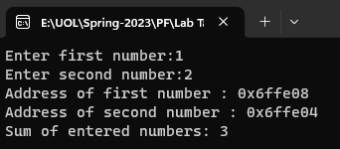
Task - 1
Write a C++ program that takes two numbers as input from the user, stores them in variables, and calculates their sum using pointers. The program should display the addresses of the variables holding the numbers and the calculated sum.

Slide 3
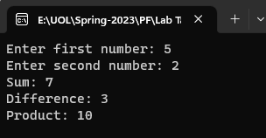
Task - 2
Write a program to implement basic mathematics (Add, Subtract, Multiply) by using functions and pointers.

Slide 4
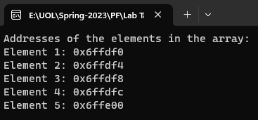
Task - 3
Write a program to declare a pointer of 1D Array and print its addresses.

Slide 5
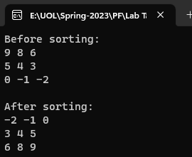
Task - 4
Write a program to sort a 2D array (using pointers).

Slide 6
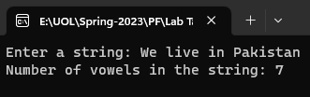
Task - 5
Write a program that counts the number of vowels in a given string using pointers. The program should ask the user to enter a string, count the number of vowels (a, e, i, o, u) using pointers in a function, and display the count.

Slide 7
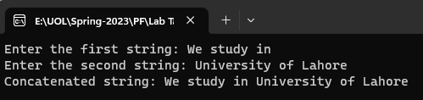
Task - 6
Write a program to concatenate two strings using pointers. The program should prompt the user to enter two strings, concatenate them using pointers, and display the concatenated string.

Slide 8
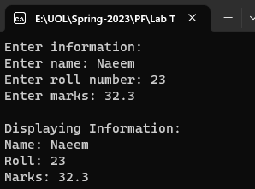
Task - 7
Write a program to store and display information using structure

Slide 9
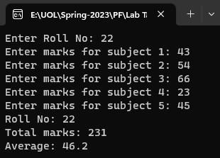
Task - 8
Write a program that declares a structure to store roll number and marks of five subjects. It defines a structure variable, inputs the values and displays roll no, marks and average marks.

Slide 10
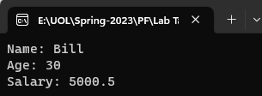
Task - 9
Write a program that demonstrates the passing of entire structure as parameters to the called function.

